Slide 1
A model to study the biological effects of Epstein-Barr virus in epithelial cells
Mark Eichelberg
Johannsen Lab

Slide 2

Epstein-Barr virus (EBV)
Infects >90% of adult population
Causative agent of:
“Mono”
B cell lymphomas
Nasopharyngeal carcinoma (NPC)
~10% of stomach cancers
AIDS-related cancers

Slide 3
Two modes of EBV infection
Latent
Lytic
Few viral genes expressed
Episomal viral DNA
No virions
Most viral genes expressed
Linear viral DNA
Extracellular virions

Slide 4
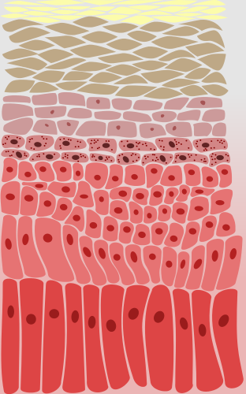
EBV in “normal” infections vs. cancer
Differentiated
layers
Basal layer
B cells
Initial infection
Annual Deaths
Lytic infection in
differentiated cells,
viral shedding in
saliva
EBV Carcinomas
NPC | 63,000
Gastric | 69,000
EBV is latent
in all
malignancies
EBV Lymphomas
PTLD | 600
Burkitt | 2,300
Hodgkin | 7,900
B cells act as
reservoir for
latent virus
Data from Khan, et al., Infect Agent Cancer 2014
Epidermis image by Fulvio314

Slide 5
Normal Oral Keratinocytes (NOKs) as an in vitro model to study EBV
NOK-EBV
NOK-G418
DJ Nawandar, Kenney Lab
Notes:
However we know comparatively little about the regulation of EBV replication in epithelial cels

Slide 6
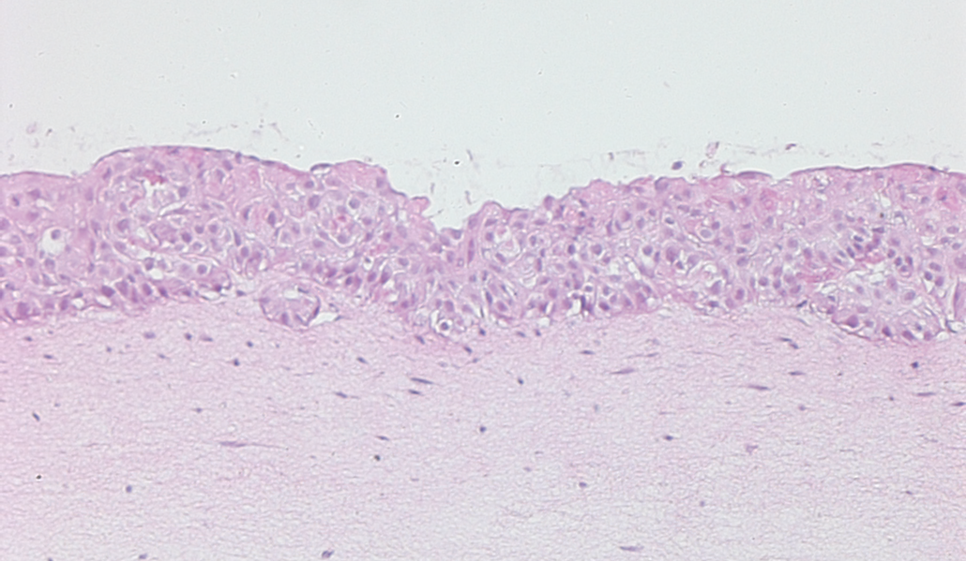
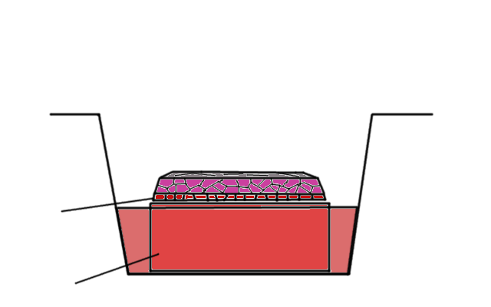
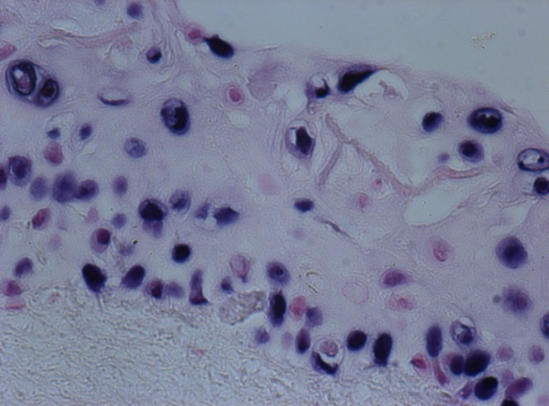
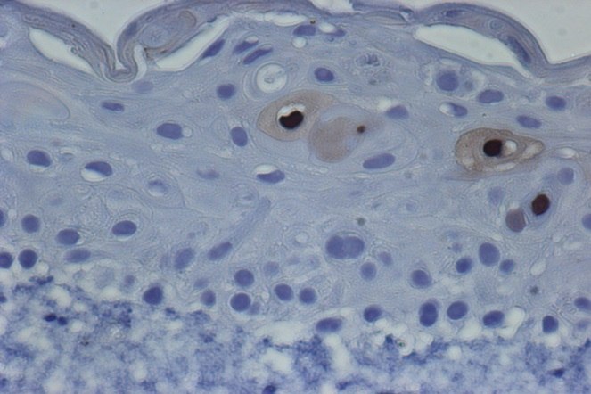
NOKs can be induced to differentiate
Raft Culture
EBER
Undifferentiated cells seeded on top of collagen layer
Collagen + fibroblasts feed cells and absorb media
Zta

Slide 7
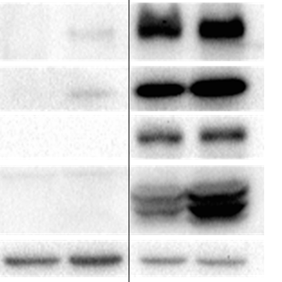
Chemical differentiation of NOKs induces EBV replication
No stim
Ca²⁺/serum
MC 48h
MC 72h
Chemical induction
Involucrin
Zta
Rta
EA-D
Tubulin
+ Ca²⁺ and serum or methylcellulose
(differentiation stimulus)

Slide 8
Learning from the NOK-EBV model
How is differentiation linked with lytic activation?
How does latent EBV infection push epithelial cells toward oncogenesis?

Slide 9
RNA-seq to identify gene expression changes
MC 3+3 reps
Ca/FBS 3+3 reps
Undifferentiated 4+4 reps
NOK
NOK-EBV
Treatment for 48 hours; NOKs also G418 selected

Slide 10
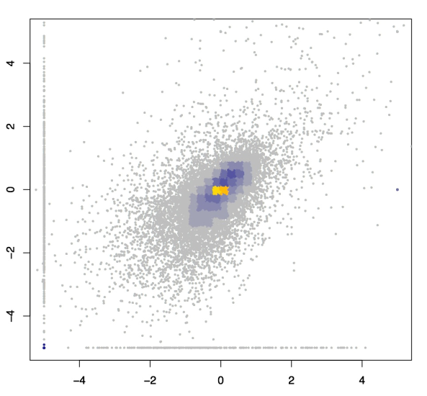
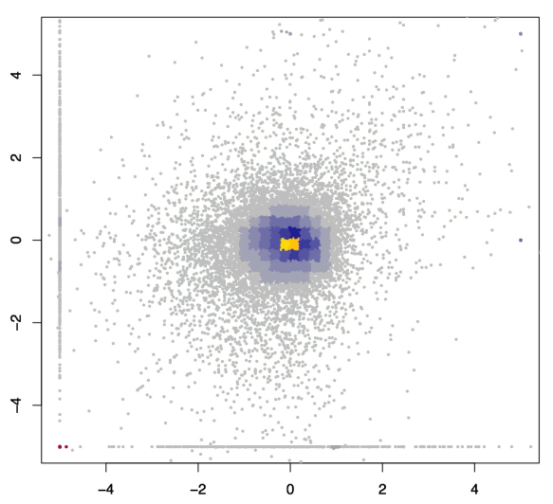
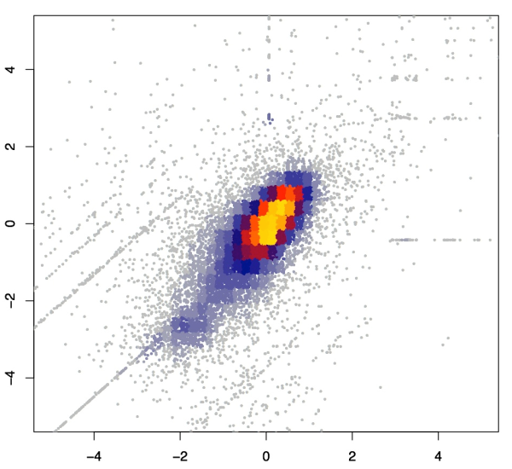
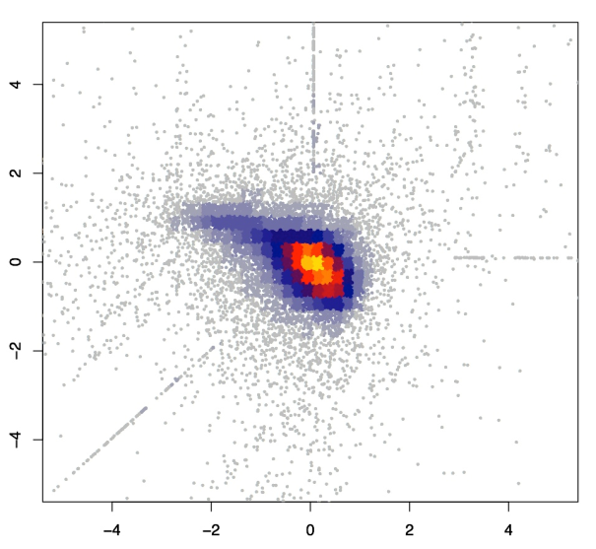
MC and Ca/FBS treatments have comparable gene effects
Cuffdiff
EBV
MC
CaFBS
CaFBS
DEseq2
MC
EBV
CaFBS
CaFBS

Slide 11
MC is a stronger inducer of differentiation
than Ca/FBS
Cornified
 | NOK RNA-seq
Gene Name | Ca²⁺/serum | Methylcellulose
Loricrin | 0 | 2.74
Filaggrin | 0 | 0
Transglutaminase 1 | 1.96 | 6.13
Transglutaminase 3 | N/S | 8.37
Transglutaminase 5 | 1.63 | 6.09
Involucrin | 3.23 | 9.63
Cornifin 1B | 3.45 | 8.99
Cornifin 2A | 5.04 | 7.02
Cornifin 2D | 3.96 | 5.88
Keratin 5 | -1.18 | 0.49
Keratin 14 | -1.09 | 1.58
Granular
Spinous
Basal
Gene changes listed as
log₂ fold change

Slide 12
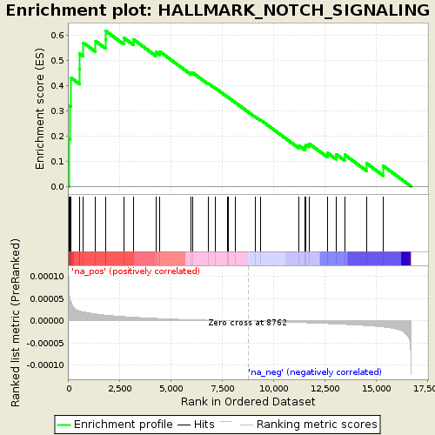
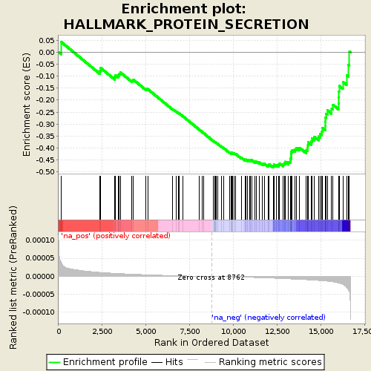
GSEA indicated pathways to investigate
Pathway | NES | q-value
EMT | 2.1 | 0.0
Notch | 1.8 | < 0.004
Hedgehog | 1.7 | < 0.008
K-ras | 1.63 | < 0.01
Wnt | 1.43 | 0.03
Inflammatory Resp | 1.43 | 0.03
TGF-beta | 1.42 | 0.03
Pathway | NES | q-value
E2F targets | -2.5 | 0.0
G2M checkpoint | -2.5 | 0.0
Protein secretion | -1.8 | 0.001
mTORC | -1.42 | 0.05

Slide 13
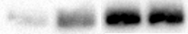
Notch signaling is elevated in NOK-EBV
Gene | NOK | NOK-EBV | Ratio
NOTCH1 | 7 | 58 | 8.8
NOTCH2 | 62 | 54 | 1.0
NOTCH3 | .0075 | 0.0225 | 2.1
NOTCH4 | 5.5 | 11 | 2.3
JAG1 | 50 | 140 | 2.8
JAG2 | 60 | 68 | 1.2
DLL1 | 23.5 | 16.6 | 0.7
DLL3 | 0.9 | 1.6 | 1.8
DLL4 | 0.2 | .06 | 0.2
NOK NOK-EBV
NT C/S NT C/S
Receptors
Active
NOTCH1
Notch Target Gene Expression
 | NOK | NOK-EBV
P21 Waf1 | 62 | 276
HES2 | 17 | 54
HEY2 | 0.01 | 0.18
Ligands
Gene expression values in TPM

Slide 14
Notch signaling in keratinocytes is driven by p53 switch
Notch1
signaling
p53
p63

Slide 15
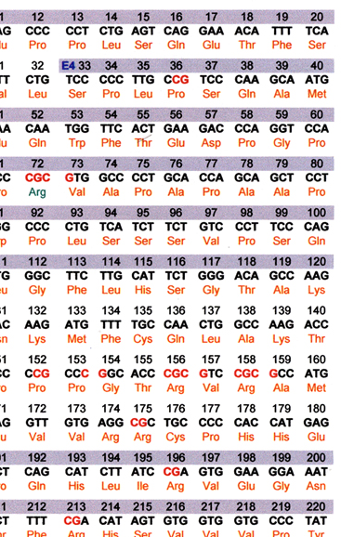
p53 was mutated in EBV- NOKs
p53 K120E

Slide 16
p53 was mutated in NOKs without EBV
p53
K120E
Notch1
p53
Notch1
NOK NOK-EBV
NT C/S NT C/S
Active
NOTCH1
NOK
mutant p53
NOK-EBV
wt p53

Slide 17
One Codex gives us a measure of quality control
All Cells were negative by MycoAlert assay prior to RNA preps

Slide 18
Opportunity to analyze data from Scott lab
MC 4+4 reps
p53 wt
SMRV-
Myco-
Undiff 4+3 reps
NOK
NOK-EBV
Treatments x 24 hours;
NOKs also G418 and GFP selected

Slide 19
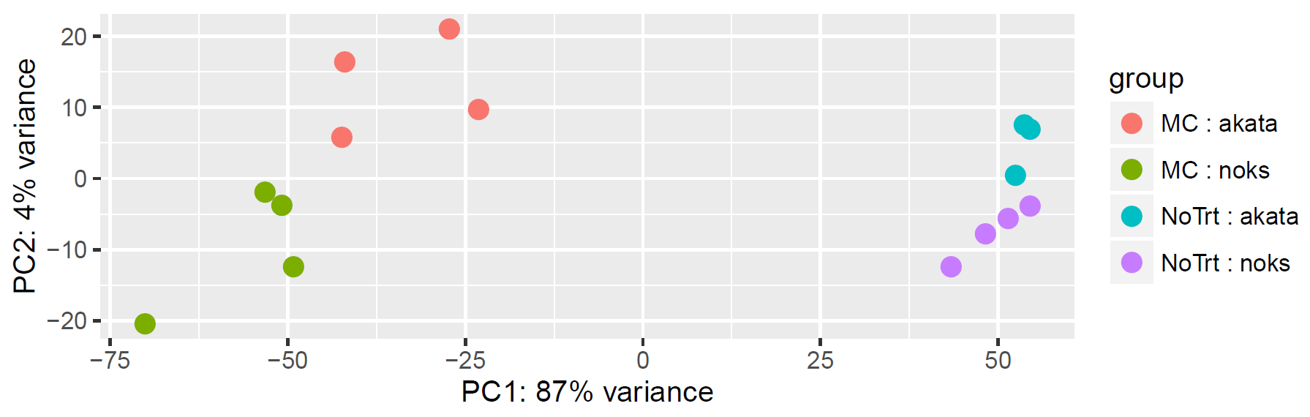
Principle component analysis of Scott lab data
+ EBV -
+ Methylcellulose -

Slide 20
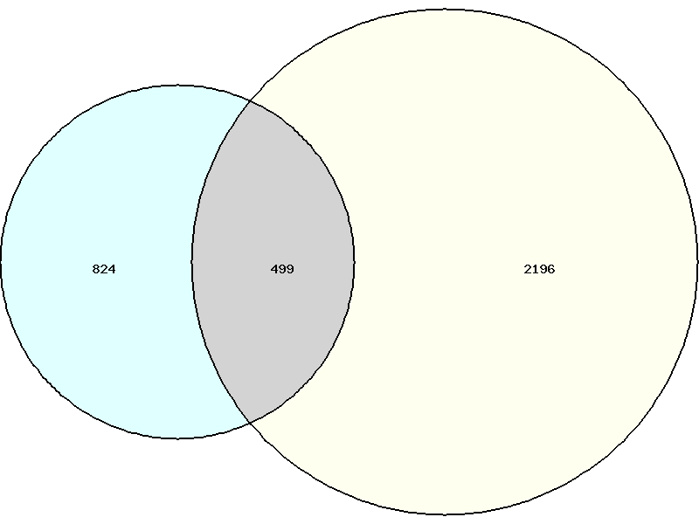
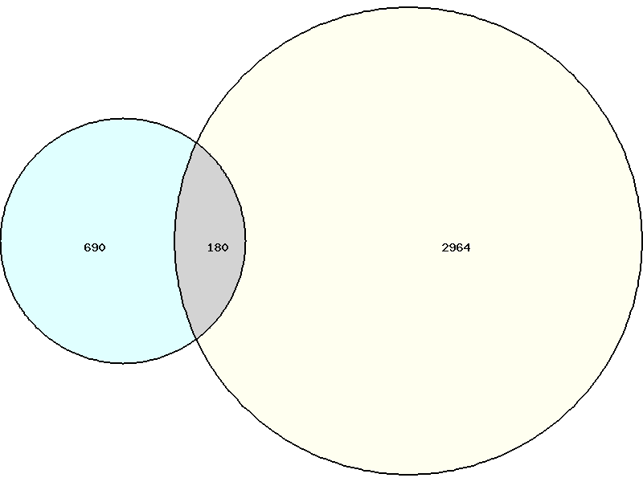
Gene changes with MC: Old vs. New
Upregulated genes
Downregulated genes
RS Data
RS Data
Old Data
Old Data
824
499
2196
690
179
2964
Significance cutoff: p < 0.0001, base expression level >100

Slide 21
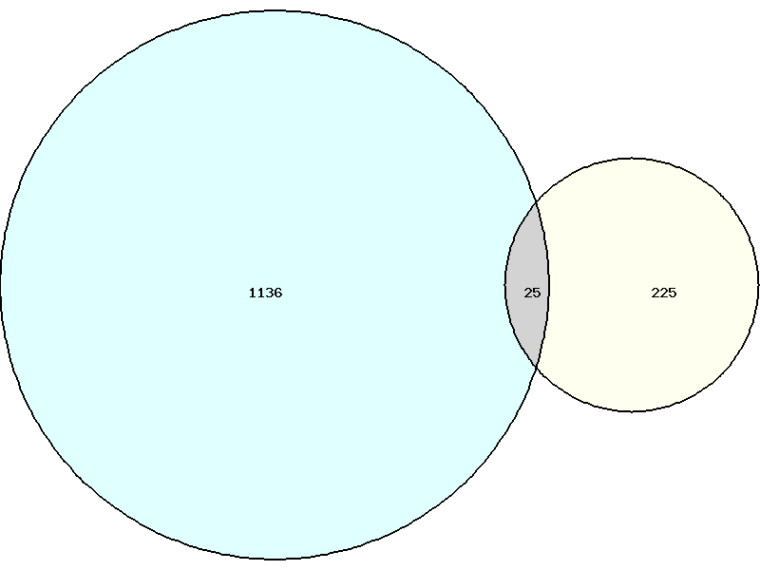
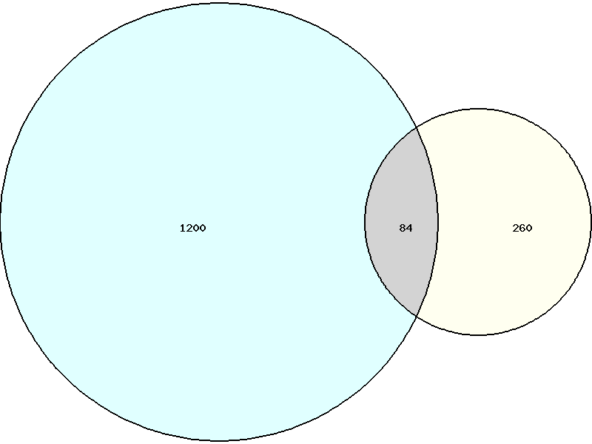
Gene changes with EBV: Old vs. New
Upregulated genes
Downregulated genes
Old Data
Old Data
RS Data
RS Data
1136
26
225
1200
84
260
Significance cutoff: p < 0.01, base expression level >100

Slide 22
Differentiation-associated genes: Old vs. New
 | NOK RNA-seq
Gene Name | Old data | RS Data
Loricrin | 2.74 | 3.15
Filaggrin | 0 | 1.90
Transglutaminase 1 | 6.13 | 9.62
Transglutaminase 3 | 8.37 | 8.98
Transglutaminase 5 | 6.09 | 9.66
Involucrin | 9.63 | 8.55
Cornifin 1B | 8.99 | 8.85
Cornifin 2A | 7.02 | 7.36
Cornifin 2D | 5.88 | 6.53
Keratin 5 | 0.49 | 0.31
Keratin 14 | 1.58 | -0.69
Late
differentiation
Early differentiation
Basal
Gene changes listed as
log₂ fold change

Slide 23
Hypotheses will be tested in multiple NOK-EBV lines
Cell Line | EBV
NOK-RS-EBV | +
NOK-2011-C1-EBV | +
NOK-2011-C3-EBV | +
NOK-BS-C1-EBV | +
NOK-RS-G418 | -
NOK-2011-C1-G418 | -
NOK-2011-C3-G418 | -
NOK-2011-C6-G418 | -

Slide 24
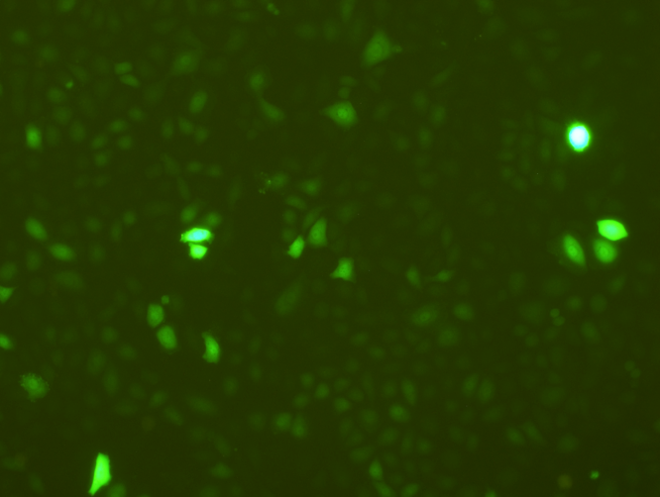
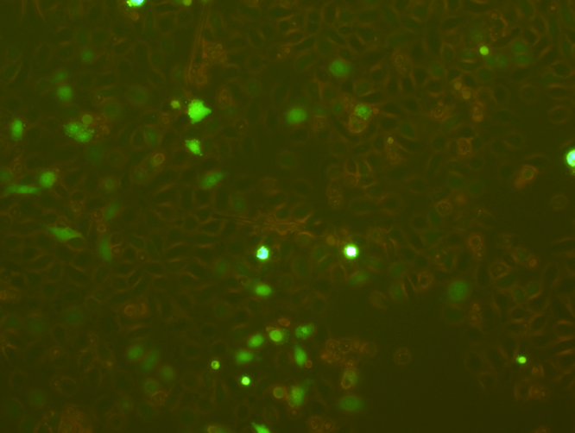
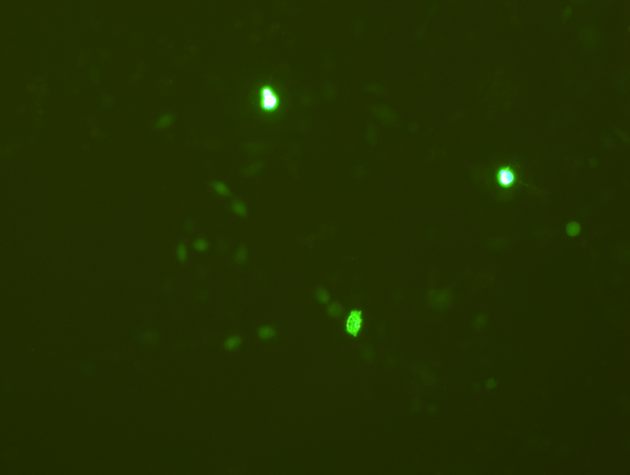
Hypotheses will be tested in multiple NOK-EBV lines
NOK-RS-EBV NOK-2011-C1-EBV NOK-2011-C3-EBV

Slide 25
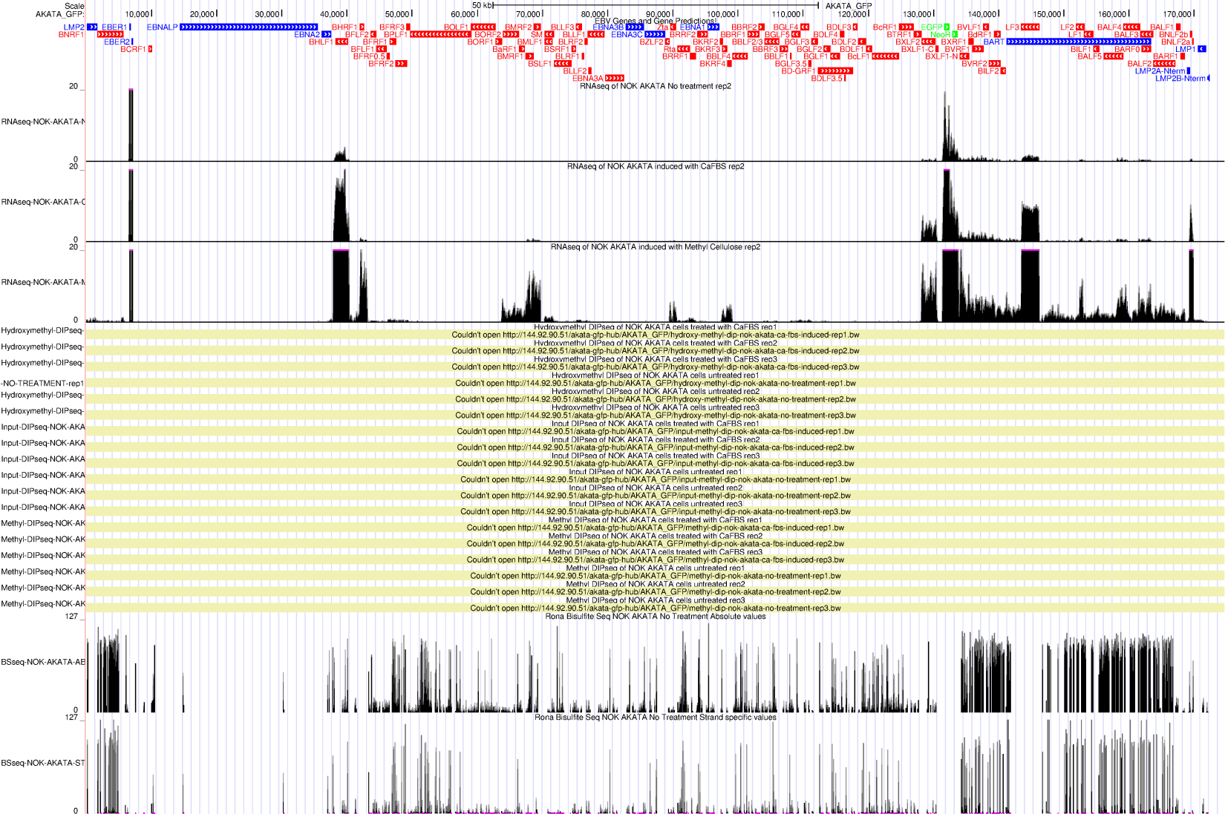
EBV deletion mutants to study mechanisms
BARTs
EBERs
BHLF1
BMRF1
Zta/Rta
LF3
GFP/Neo
3’ UTR
BNLF2a/b
Latency Genes
Lytic Genes
Marker Genes
BARTs KO
EBERs KO
Zta/Rta KO

Slide 26
Can we correlate RNA-seq data with MeDIP data?
Input
5hmC
5mC

Slide 27
What we would like to do
Analyze Scott lab data
DE seq values for RS EBV+MC data
Discriminant non-negative matrix factorization for GSEA
Other techniques for hypothesis generation?
Can we correlate RS data with epigenetic data (MeDIP)?
Can we reconcile our old data with new RS data?

Slide 28
Acknowledgments
Johannsen Lab
Makoto Ohashi
Reza Djavadian
Ahmed Ali
Alex Satchie
Former members:
Ben Korte
Kyle McChesney
Kenney Lab Collaborators
DJ Nawandar
Lambert Lab
Kathleen Makielski
Committee
Eric Johannsen
Paul Lambert
Rupa Sridharan
Sunduz Keles
Shannon Kenney
Funding
NIH

